Slide 1
Robotics 2: Pacman
Stijn Everink
Robin de Heer
Wouter van der Ven
Joris van Vugt
Job van Drunen
Gideon Hoogeveen

Slide 2
Index
Project summary
Project motivation
Problem description
Work description
Results
Further improvements

Slide 3
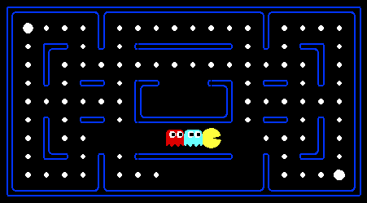
Project summary
Real life, Real time Pacman.
1 Human controlled Pacman
2 AI controlled ghosts
Computer vision
Everything is controlled by a PC

Slide 4

Project motivation

Slide 5

Problem description
Computer vision most difficult part
OpenCV library
Circle recognition
Colour and contrast were very important
Front
Rotation
Rotation axis
Back

Slide 6
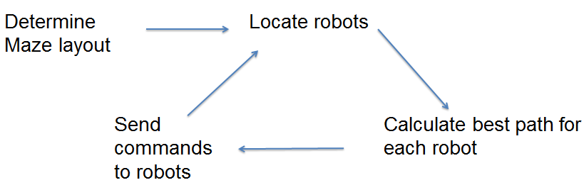
Problem description (2)

Slide 7
Work description

Slide 8
Results
Works for any maze layout
Ghosts will try to surround Pacman
GUI to make Pacman move

Slide 9
Further improvements
Some scoring mechanism (like food in Pacman)
Larger mazes
Higher resolution video and less delay

